Slide 1
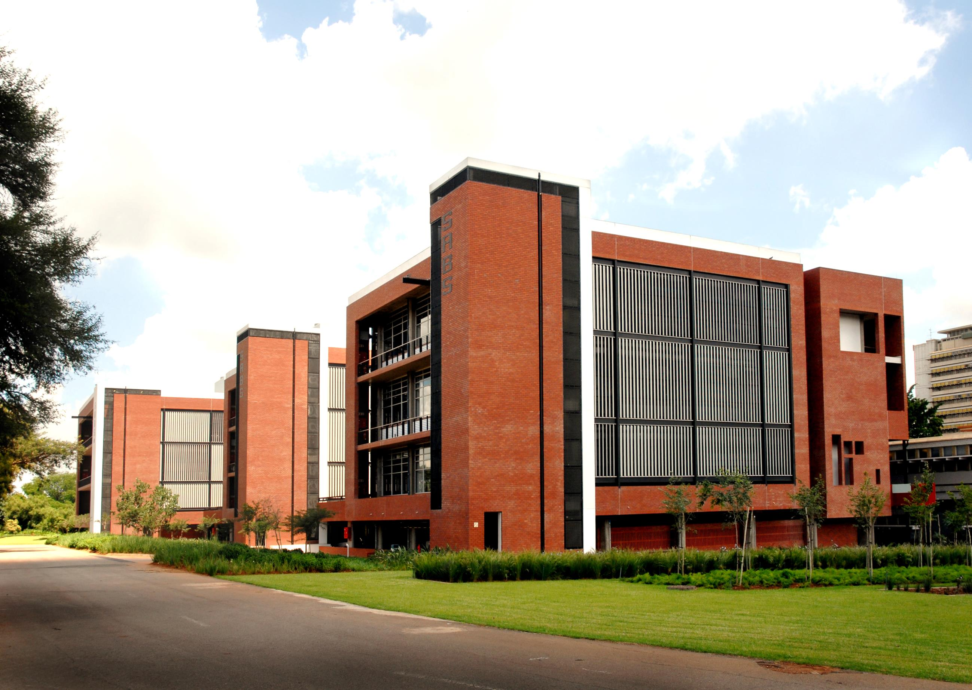
National Sanitary & Phytosanitary Workshop 2021
FOOD SAFETY
PRESENTED BY : KAY NAIDOO
Group Manager – Training Academy

Slide 2
OUR SHAREHOLDER
FOOD SAFETY

Slide 3
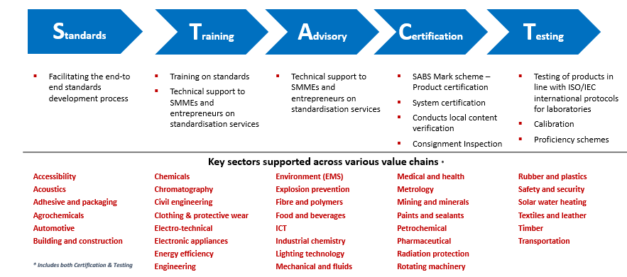
OUR VALUE CHAIN
FOOD SAFETY

Slide 4
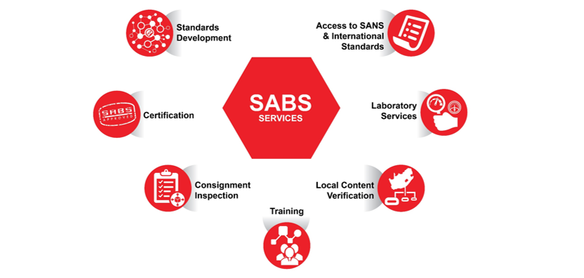
OUR SERVICES
FOOD SAFETY
SABS COMMERCIAL SOC Ltd

Slide 5
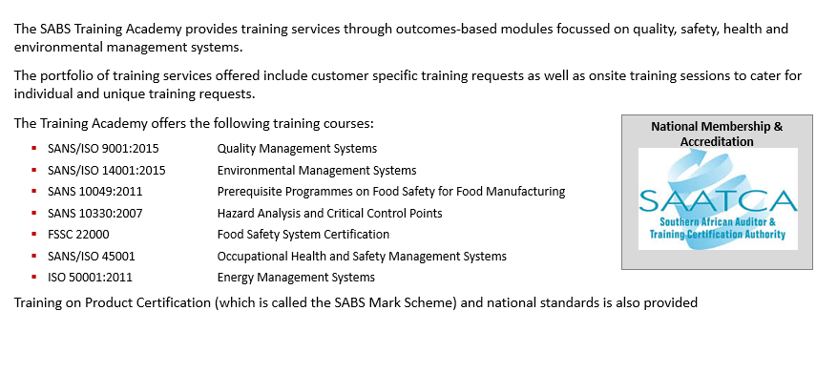
OUR TRAINING ACADEMY
FOOD SAFETY

Slide 6
FOOD SAFETY
Assurance that food will not cause an adverse health effect for the consumer when it is prepared and/or consumed in accordance with its intended use
Food Safety is a way of making sure that food is produced in ways that prevent food-borne illnesses.
Therefore food safety also simply means “meeting customer’s food safety requirements”.

Slide 7
FOOD SAFETY MANAGEMENT SYSTEMS
Structured business strategy
Meet legislation and regulations
HACCP
SANS 10330
ISO 22000

Slide 8
STEPS FOR IMPLEMENTING A FOOD SAFETY SYSTEM
FSSC 22000 – GFSI Recognised scheme
HACCP (R908 –FCD Act)
CODEX
FSMS
ISO 22000
PRP’s
SANS 10049, ISO/TS 22002
GMP’s
SA- Regulation 638 – FCD Act

Slide 9
REGULATORY LANDSCAPE IN SOUTH AFRICA
Dept of Health
www.doh.gov
Dept of Agriculture Forestry & Fisheries
www.daff.gov
Dept of Trade & industry
www.dti.gov
CPA
NRCS
Meat Safety Act
Agricultural Products Standards Act
FCD Act
Various regulations
R 638
R 908
SABS
National standards
Regulatory fish, canned meat

Slide 10
REGULATION 908 (HACCP)
REGULATIONS RELATING TO THE HAZARD ANALYSIS AND CRITICAL CONTROL POINT SYSTEM (HACCP SYSTEM)
PUBLISHED – 2003
NO MANDATORY SECTORS - GENERIC
NOVEMBER 2009 - AMENDMENT - outbreak of Aflatoxins in peanut butter
SECTOR | FOOD HANDLING ENTERPRISE | DATE LISTED
VEGETABLES, FRUIT, NUTS OR OTHER PARTS OF PLANTS PREPARATIONS AND PRODUCTS | PROCESSORS: GROUNDNUTS: a. Peanut sorting/grading Facilities b. Peanut butter Manufacturers | Within one year of the publication of the final notice (DEC 2010)

Slide 11
REGULATION 908 (HACCP)
JUNE 2018- AMENDMENT (Lesteria Outbreak)
SECTOR | FOOD HANDLING ENTERPRISE | DATE LISTED
MEAT AND EDIBLE MEAT OFFAL, PREPARATIONS AND PRODUCTS | ALL PROCESSORS OF READY -TO -EAT HEAT TREATEDMEAT PRODUCTSAS DEFINED IN SANS 885 | WITHIN NINE (9) MONTHS OF THE PUBLICATION OF THIS NOTICE (MARCH 2019)
POULTRY, PREPARATIONS AND PRODUCTS | All PROCESSORS OF READY -TO -EAT HEAT TREATED POULTRY PRODUCTS AS DEFINED IN SANS 885 | WITHIN NINE (9) MONTHS OF THE PUBLICATION OF THIS NOTICE (MARCH 2019)
** SANS 885 – PROCESSED MEAT PRODUCTS

Slide 12
GETTING PRODUCT ONTO SUPERMARKET SHELVES
All major retailers in South Africa – require some sort of Food Safety Certification
GFSI Global Markets Programme
CGCSA
Global Markets Programme
FSSC 22000 Development programme

Slide 13
GLOBAL MARKETS PROGRAMME
Programme for small business
Local - Consumer Goods Forum – South Africa
International – FSSC 22000 – Development Programme
Based on international requirements – Global Food Safety Initiative
Aimed at food businesses – less developed Food Safety Management system – to render regulatory compliance
Tool to assist a small business build towards certification to a system.

Slide 14
GLOBAL MARKETS PROGRAMME
Certification to:
HACCP
ISO 22000
FSSC 22000
NB. Retailers require intermediate level
Business decision to remain on intermediate level (customer requirement)
Certificate of conformity to the appropriate level
Intermediate level
Foundation / Basic level

Slide 15
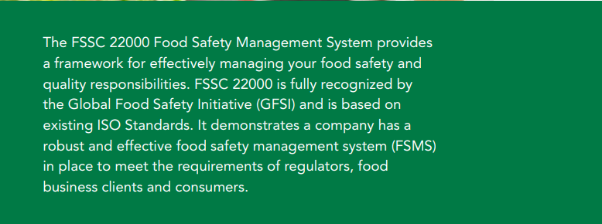
FSSC 22000 FOOD SAFETY MANAGEMENT SYSTEM
Extracted from FSSC 22000 TO library

Slide 16
FSSC 22000 V5.1
F
Food
S
System
22000
Certification
S
C
Safety
Food Safety Management System
ISO 22000: 2018
PRPs
FSSC V5 Additional requirements

Slide 17
Version 5.1
Published November 2020
Benchmarked against the GFSI version 2020.1 Requirements
FSSC 22000 Scheme version 5.1
www.fssc22000.com

Slide 18
Why FSSC 22000?
Framework for a robust and effective Food Safety Management System
Fully recognized by GFSI (Global Food Safety Initiative)
Based on existing ISO Standards
Covers the whole Food Supply Chain
Ensures reliable certification
Facilitates Integrated Management Systems
Includes Training Program
Extracted from FSSC 22000 TO library

Slide 19
Why FSSC 22000?
Globalisation complex food chains
Manufacture of safe food – primary concern worldwide
Public health
Impact on international trade & global markets

Slide 20
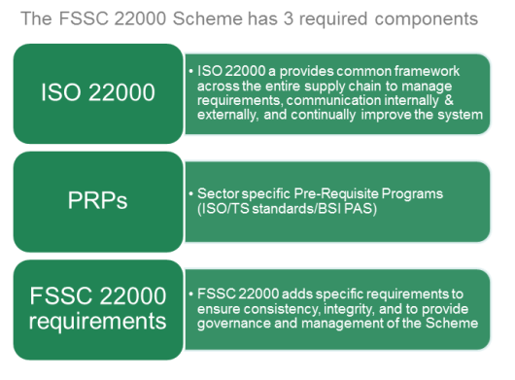
STRUCTURE OF THE SCHEME

Slide 21
About the Scheme
The Scheme consists of -
Six Parts
Two Appendices
Nine Annexes
Contain mandatory Scheme requirements.
Guidance documents on several topics to provide additional support.
downloaded for free from the FSSC 22000 website
www.FSSC22000.com

Slide 22
Scheme parts
Part 1 scheme overview
This part provides context and more details about the Scheme and its scopes.
Part 2 Requirements for organizations to be audited
This document states the Scheme requirements against which licensed Certification Bodies shall audit the FSMS or FSMS and QMS of the (applicant) organization seeking to be certified for FSSC 22000 or FSSC 22000-Quality.
Part 3 requirements for the certification process
This Part states the requirements for the execution of the certification process to be conducted by licensed CBs.

Slide 23
Scheme parts
Part 4 requirements for certification bodies
This document states the requirements for licensed certification bodies (CBs) who wish to provide FSSC 22000 or FSSC 22000-Quality certification services to organizations.
Part 5 requirements for accreditation bodies
This document specifies the criteria against which the Foundation will recognize and register Accreditation Bodies that provide accreditation to Certification Bodies
Part 6 requirements for training organizations
This document specifies the criteria against which the Foundation will recognize and register Training Organizations to deliver FSSC 22000 approved training courses.

Slide 24
Applicable (Sub)Categories and Normative Documents
Category | Sub category | Description | Example of included activities and products | Normative Documents
A | AI | Farming of animals for meat/milk/ eggs/honey | Raising animals used for meat production, egg production, milk production or honey production (associated farm packing and storage). | ISO 22000, ISO/TS 22002-3, Additional FSSC 22000 requirements
 | AII | Farming of Fish and seafood | Raising fish and seafood used for meat production (associated farm packing and storage). | ISO 22000, ISO/TS 22002-3, Additional FSSC 22000 requirements
C | CI | Processing of perishable animal products | Amongst others: Slaughtering, deboning, evisceration, gutting, cutting, sorting, washing, pasteurizing, trimming, curing, fermentation, smoking, freezing, chilling, cooling, scalding. Final product examples: fish, meat, poultry, eggs, frozen and/or chilled dairy products and fish/seafood products. | ISO 22000, ISO/TS 22002-1, Additional FSSC 22000 requirements
C | CII | Processing of perishable plant products | Amongst others: De-shelling, drying, packing, sorting, washing, rinsing, fluming, trimming, slicing, pasteurizing, roasting, scalding, peeling, de-husking, cooling, chilling, freezing and final product. Final product examples: chilled or frozen e.g. fresh fruits, fresh juices, vegetables, grains, nuts and pulses, meat replacers based on plant materials (e.g. soy) | ISO 22000, ISO/TS 22002-1, Additional FSSC 22000 requirements
C | CIII | Processing of perishable animal and plant products (mixed products) | Amongst others: mixing, cooking, packing, ensemble cooling, chilling, freezing Final products e.g. mixed products, pizza, lasagna, sandwich, dumplings, ready-to-eat meals. | ISO 22000, ISO/TS 22002-1, Additional FSSC 22000 requirements

Slide 25
Applicable (Sub)Categories and Normative Documents
Category | Sub category | Description | Example of included activities and products | Normative Documents
C | CIV | Processing of ambient stable products | Amongst others: Mixing, cooking, packing, bottling, brewing, drying, pressing, milling, blending, roasting , refining, ensemble, distilling, drying, canning, pasteurizing, sterilization. Final product examples: canned products, biscuits, bread, snacks, oil, drinking water, beverages alcoholic and nonalcoholic, pasta, flour, sugar, food-grade salt, dairy products with long shelf life, margarines. | ISO 22000: 2018 ISO/TS 22002-1, Additional FSSC 22000 requirements
D | DI | Production of feed | Production of single or multiple products, whether processed, semi-processed or raw, which are intended to be fed to food producing animals | ISO 22000: 2018, ISO/TS 22002-6, Additional FSSC 22000 requirements
D | DIIa | Production of pet food (only for dogs and cats). | Production of single or multiple products, whether processed, semi-processed or raw, which are intended to be fed to non-food producing animals being dogs and cats. Examples: Dry and wet pet food, treats, cooled, chilled, frozen and ambient stable. | ISO 22000: 2018, ISO/TS 22002-1, Additional FSSC 22000 requirements
D | DIIb | Production of pet food (for other pets). | Production of single or multiple products, whether processed, semi-processed or raw, which are intended to be fed to non-food producing animals other than dogs and cats. Examples: Dry and wet pet food, treats, cooled, chilled, frozen and ambient stable. | ISO 22000: 2018, ISO/TS 22002-6, Additional FSSC 22000 requirements
E | EI | Catering | Activities in restaurants, hotels, workplace cafeterias, handling foods at remote sites, transport and delivery directly to consumers. Activities for coffee shops, food trucks and event catering. | ISO 22000: 2018, ISO/TS 22002-2, Additional FSSC 22000 requirements

Slide 26
Applicable (Sub)Categories and Normative Documents
Category | Sub category | Description | Example of included activities and products | Normative Documents
F | FI | Retail /Wholesale | Activities: receipt, picking, storage, display of food products, dispatch, transport and delivery Examples: supermarkets; hypermarkets; convenience stores; cash and carry; mass/club stores, wholesalers selling to restaurants | ISO 22000: 2018, BSI/PAS 221, Additional FSSC 22000 requirements
G | GI | Provision of transport and storage services for perishable food and feed. | Transport and storage with cooling, chilling or frozen temperatures. Additional activities such as re-packing of packed product, freezing and thawing. | ISO 22000: 2018, ISO/TS 22002-5 Additional FSSC 22000 requirements
G | GII | Provision of transport and storage services for ambient stable food and feed. | Transport and storage. Additional activities such as re-packing of packed product. | ISO 22000: 2018, ISO/TS 22002-5, Additional FSSC 22000 requirements
I | I | Production of food packaging and packaging materials. | All manufacturing activities for plastic, carton, paper, metal, glass, wood and other materials to be used as packaging materials in the food/feed industry. Examples: bottles, boxes, jars, barrels, cork, cans; devices for closing packaging materials such as tape, plastic strips, or other when the manufacturer can prove that they belong to a food/ feed packaging material; Production of labels with direct food contact. | ISO 22000: 2018, ISO/TS 22002-4, Additional FSSC 22000 requirements
K | K | Production of Bio-chemicals | Amongst others: mixing, cooking, packing, distilling, drying, canning, sterilization for all products at ambient, chilled and frozen temperatures. Final products: e.g. food and feed additives, vitamins, minerals, bio-cultures, flavorings, enzymes and processing aids, gases as ingredients and/or packaging gas. | ISO 22000: 2018, ISO/TS 22002-1, Additional FSSC 22000 requirements

Slide 27
Technical specifications
ISO/TS 22002-1:2009 Prerequisites for food manufacturing
ISO/TS 22002-2:2013 Prerequisites for catering
ISO/TS 22002-3:2011 Prerequisites for farming
ISO/TS 22002-4:2013 Prerequisites for food packaging manufacturing
ISO/TS 22002-5:2019 Prerequisites for logistics
ISO/TS 22002-6:2016 Prerequisites for animal feed
BSI/PAS 221:2013 Prerequisites for retail / supermarkets
Extracted from FSSC 22000 TO library

Slide 28
FSSC 22000 additional requirements
1) Management of services and purchased materials
2) Product labelling
3) Food defense
4) Food fraud mitigation
5) Logo use
6) Management of allergens (Food chain categories C, E, FI, G, I & K)
7) Environmental monitoring (Food chain categories C, I & K)
8) Formulation of products (Food chain category D)
9) Transport and delivery (Food chain category FI)
10) Storage and Warehousing (All Food Chain Categories)
11) Hazard Control and Measures for Preventing Cross-Contamination (Food chain category C, I)
12) PRP Verification (Food chain categories C, D, G, I & K)
13) Product Development (Food chain categories C, D, E, F, I & K)
14) Health Status (Food chain category D)
15) Requirements for Organizations with Multi-site certification (Food chain categories A, E, FI & G)
Extracted from FSSC 22000 TO library

Slide 29
TRAINING ACADEMY
TRAINING COURSES OFFERED
Fssc awareness
Fssc 22000 V5.1 Implementation
Fssc 22000 V5.1 internal auditing
Fssc 22000 V5.1 lead auditing
Fssc 22000 v5.1 transition
For more info Email: tcpsales@sabs.co.za

Slide 30
THANK YOU
FOR ADDITIONAL INFORMATION
Email: info@sabs.co.za

